Slide 1
Chapter 3:
The Enhanced E-R Model and Business Rules
Modern Database Management
10th Edition
Jeffrey A. Hoffer, Mary B. Prescott,
Heikki Topi
© 2009 Pearson Education, Inc. Publishing as Prentice Hall

Slide 2
Objectives
Definition of terms
Use of supertype/subtype relationships
Use of generalization and specialization techniques
Specification of completeness and disjointness constraints
Develop supertype/subtype hierarchies for realistic business situations
Develop entity clusters
Explain universal data model
Name categories of business rules

Slide 3
Supertypes and Subtypes
Subtype: A subgrouping of the entities in an entity type that has attributes distinct from those in other subgroupings
Supertype: A generic entity type that has a relationship with one or more subtypes
Attribute Inheritance:
  Subtype entities inherit values of all attributes of the supertype
  An instance of a subtype is also an instance of the supertype
Notes:
Subtype: A subgrouping of the entities
Supertype: A generic entity type that has a relationship with one or more subtypes
Attribute Inheritance:
Subtype entities inherit values of all attributes of the supertype
An instance of a subtype is also an instance of the supertype

Slide 4
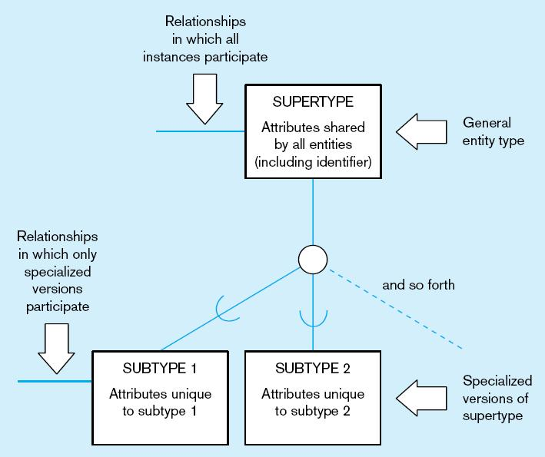
Figure 4-1 Basic notation for supertype/subtype notation
a) EER notation

Slide 5
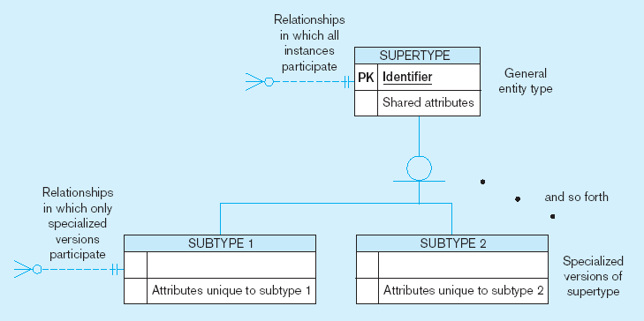
Figure 4-1 Basic notation for supertype/subtype notation (cont.)
b) Microsoft Visio Notation
Different modeling tools may have different notation for the same modeling constructs

Slide 6
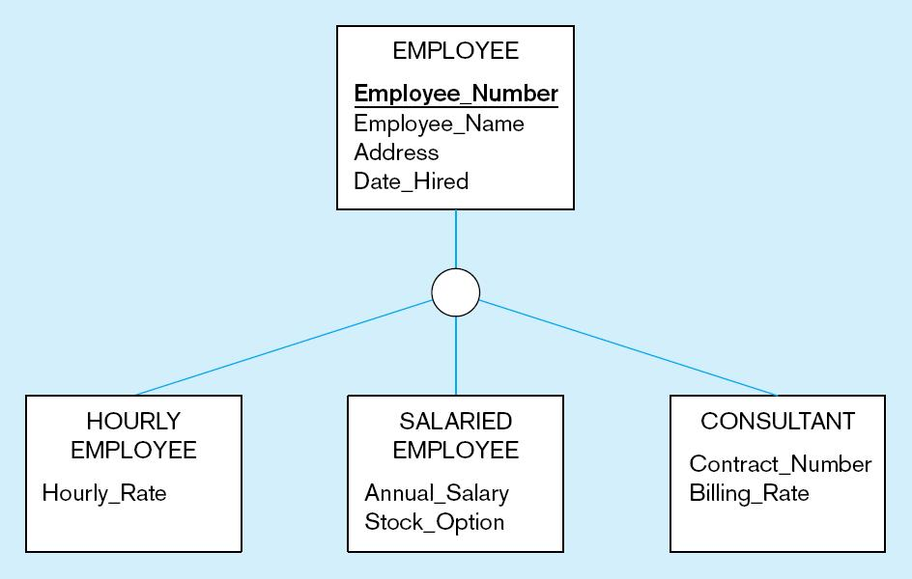
Figure 4-2 Employee supertype with three subtypes
All employee subtypes will have emp nbr, name, address, and date hired
Each employee subtype will also have its own attributes

Slide 7
Relationships and Subtypes
Relationships at the supertype level indicate that all subtypes will participate in the relationship
The instances of a subtype may participate in a relationship unique to that subtype. In this situation, the relationship is shown at the subtype level
Notes:
Relationships at the supertype -> all instances participate
The instances of a subtype may or may not participate in a relationship

Slide 8
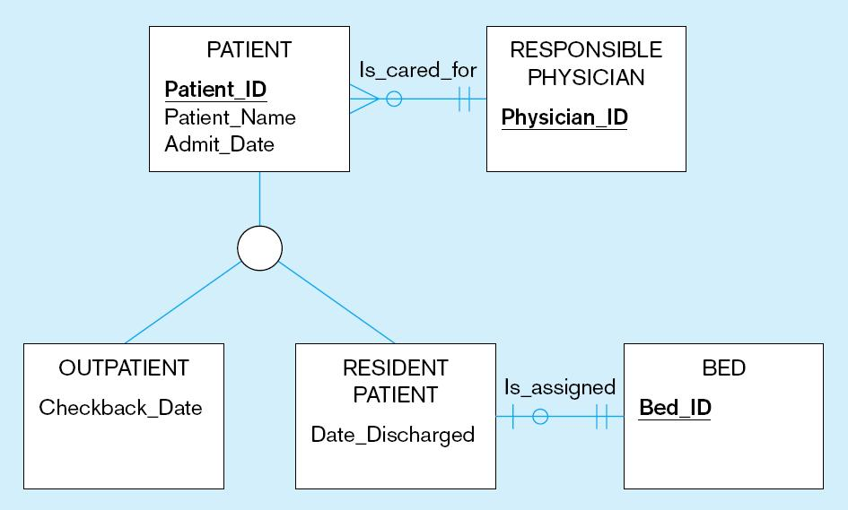
Figure 4-3 Supertype/subtype relationships in a hospital
Both outpatients and resident patients are cared for by a responsible physician
Only resident patients are assigned to a bed

Slide 9
Generalization and Specialization
Generalization: The process of defining a more general entity type from a set of more specialized entity types. BOTTOM-UP
Specialization: The process of defining one or more subtypes of the supertype and forming supertype/subtype relationships. TOP-DOWN

Slide 10
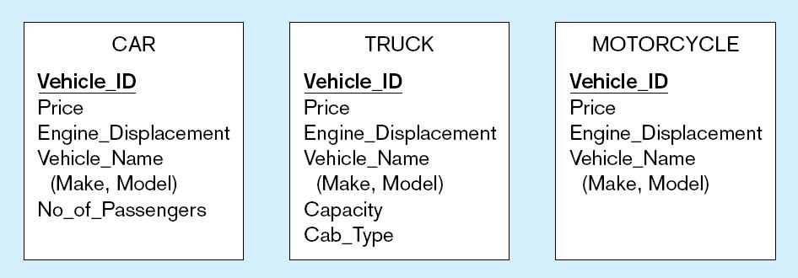
Figure 4-4 Example of generalization
a) Three entity types: CAR, TRUCK, and MOTORCYCLE
All these types of vehicles have common attributes

Slide 11
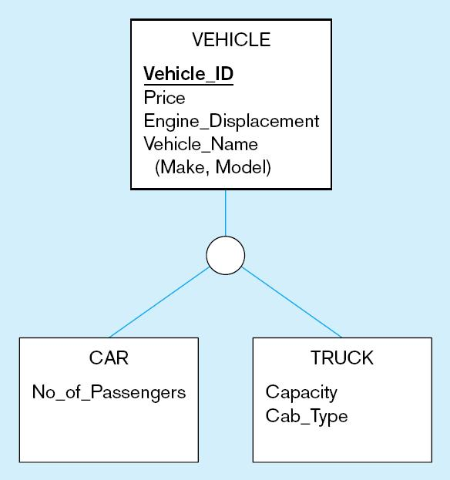
Figure 4-4 Example of generalization (cont.)
b) Generalization to VEHICLE supertype
So we put the shared attributes in a supertype
Note: no subtype for motorcycle, since it has no unique attributes

Slide 12
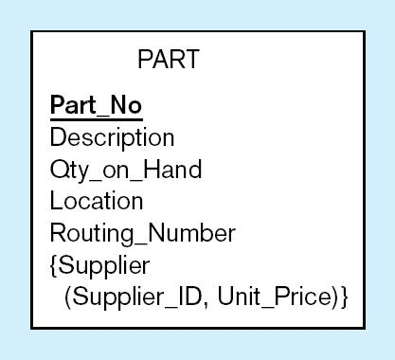
Figure 4-5 Example of specialization
a) Entity type PART
Only applies to manufactured parts
Applies only to purchased parts

Slide 13
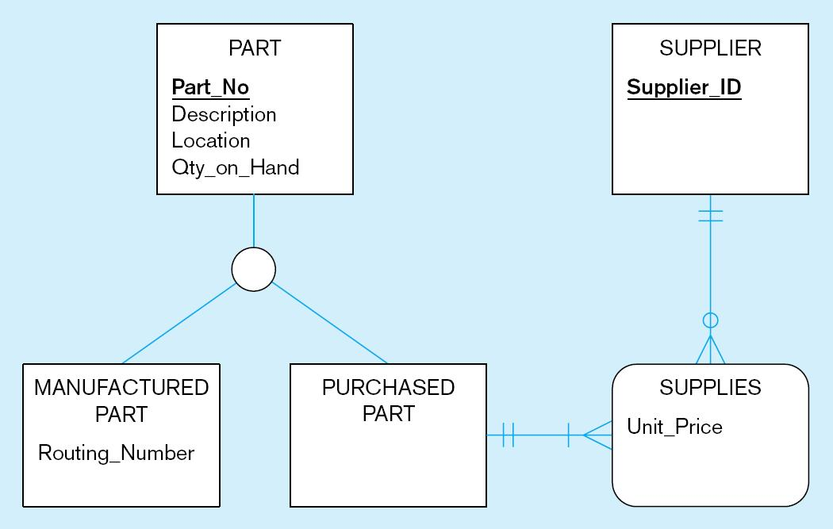
Figure 4-5 Example of specialization (cont.)
b) Specialization to MANUFACTURED PART and PURCHASED PART
Created 2 subtypes
Note: multivalued attribute was replaced by an associative entity relationship to another entity

Slide 14
Constraints in Supertype/ Completeness Constraint
Completeness Constraints: Whether an instance of a supertype must also be a member of at least one subtype
  Total Specialization Rule: Yes (double line)
  Partial Specialization Rule: No (single line)

Slide 15
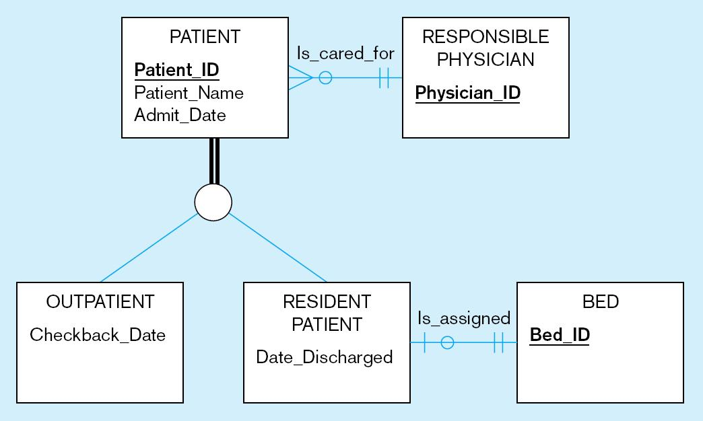
Figure 4-6 Examples of completeness constraints
a) Total specialization rule
A patient must be either an outpatient or a resident patient

Slide 16
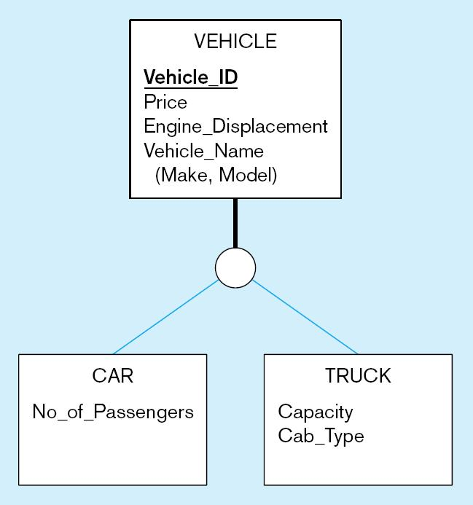
Figure 4-6 Examples of completeness constraints (cont.)
b) Partial specialization rule
A vehicle could be a car, a truck, or neither

Slide 17
Constraints in Supertype/ Disjointness constraint
Disjointness Constraints: Whether an instance of a supertype may simultaneously be a member of two (or more) subtypes
  Disjoint Rule: An instance of the supertype can be only ONE of the subtypes
  Overlap Rule: An instance of the supertype could be more than one of the subtypes

Slide 18
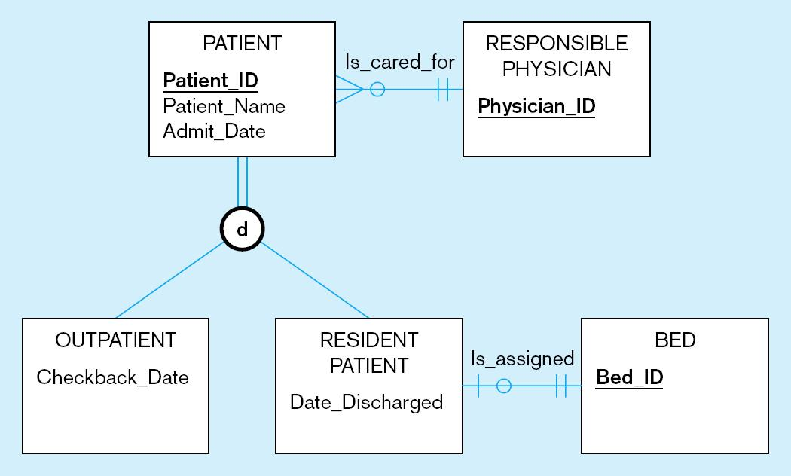
Figure 4-7 Examples of disjointness constraints
a) Disjoint rule
A patient can either be outpatient or resident, but not both

Slide 19
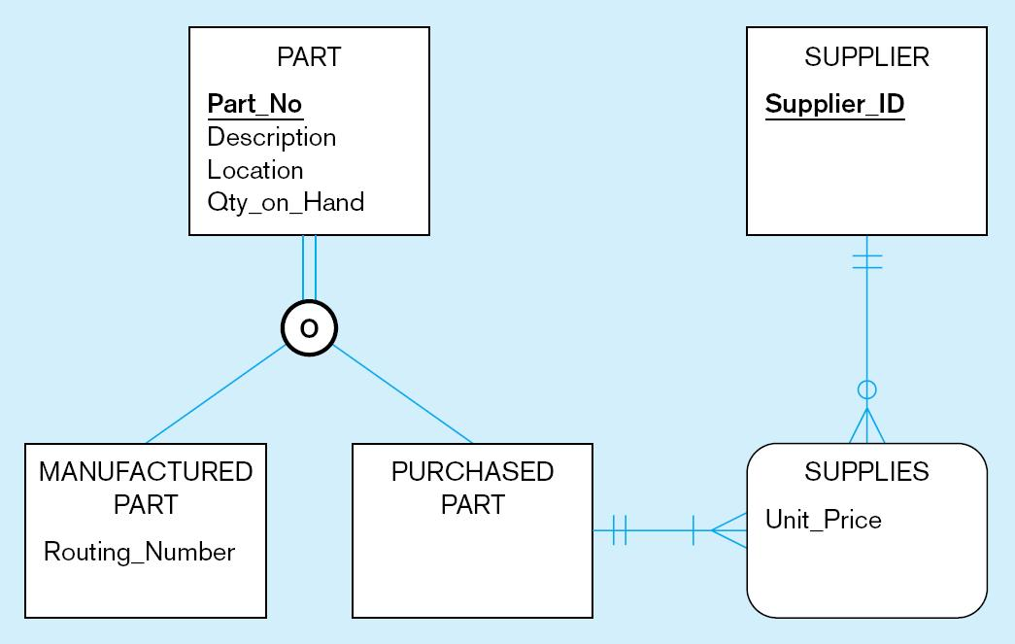
Figure 4-7 Examples of disjointness constraints (cont.)
b) Overlap rule
A part may be both purchased and manufactured

Slide 20
Constraints in Supertype/ Subtype Discriminators
Subtype Discriminator: An attribute of the supertype whose values determine the target subtype(s)
  Disjoint – a simple attribute with alternative values to indicate the possible subtypes
  Overlapping – a composite attribute whose subparts pertain to different subtypes. Each subpart contains a boolean value to indicate whether or not the instance belongs to the associated subtype

Slide 21
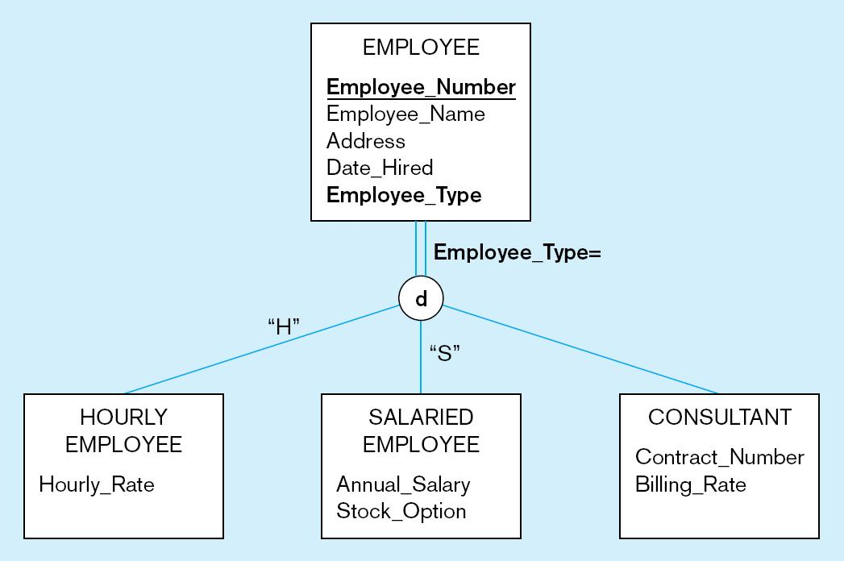
Figure 4-8 Introducing a subtype discriminator (disjoint rule)
A simple attribute with different possible values indicating the subtype

Slide 22
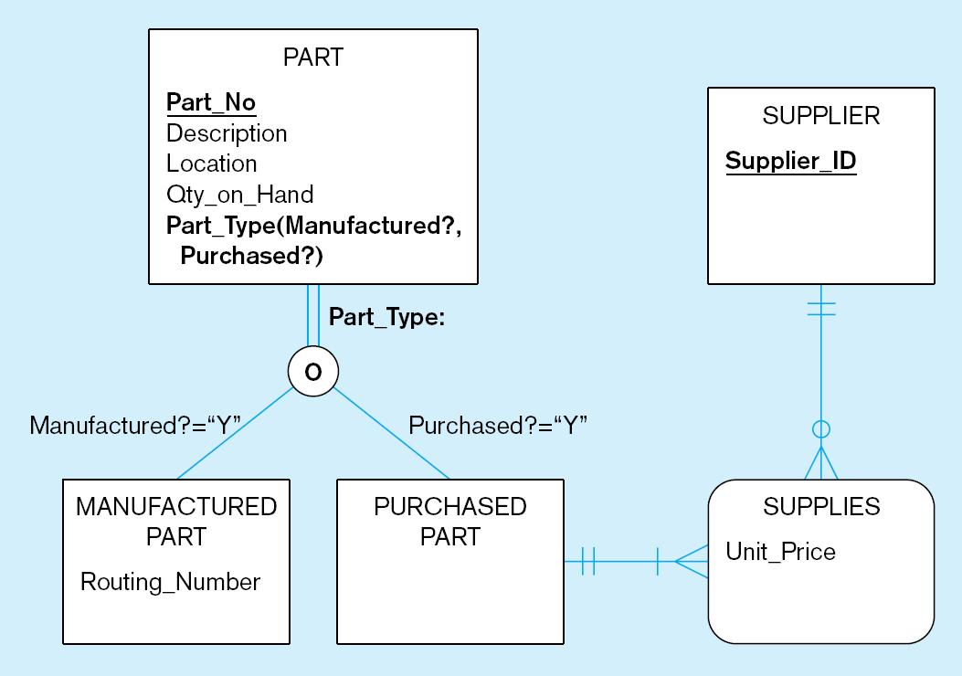
Figure 4-9 Subtype discriminator (overlap rule)
A composite attribute with sub-attributes indicating “yes” or “no” to determine whether it is of each subtype

Slide 23
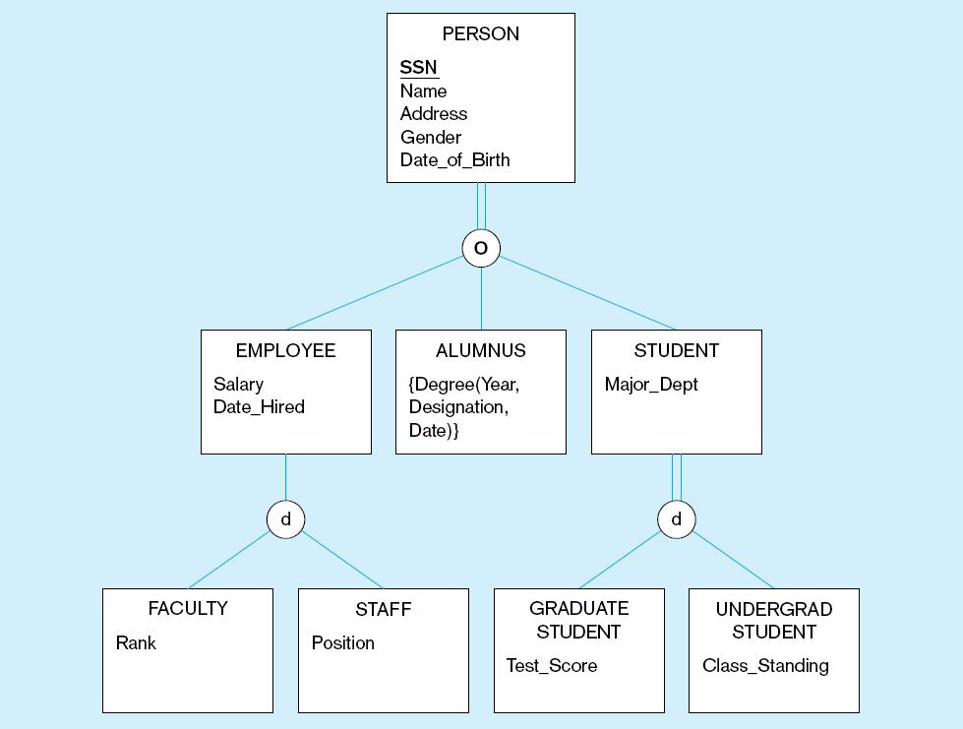
Figure 4-10 Example of supertype/subtype hierarchy

Slide 24
Entity Clusters
EER diagrams are difficult to read when there are too many entities and relationships
Solution: Group entities and relationships into entity clusters
Entity cluster: Set of one or more entity types and associated relationships grouped into a single abstract entity type

Slide 25
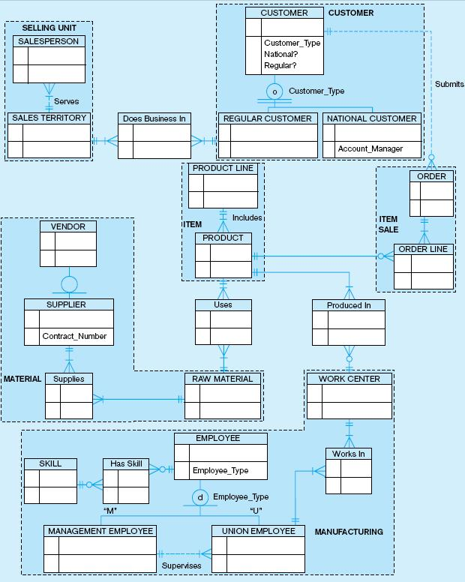
Figure 4-13a Possible entity clusters for Pine Valley Furniture in Microsoft Visio
Related groups of entities could become clusters

Slide 26
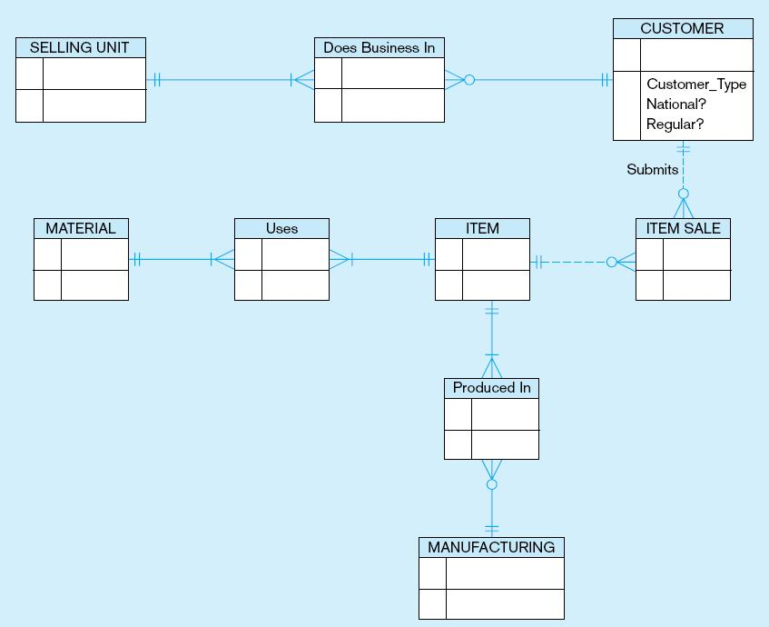
Figure 4-13b EER diagram of PVF entity clusters
More readable, isn’t it?

Slide 27
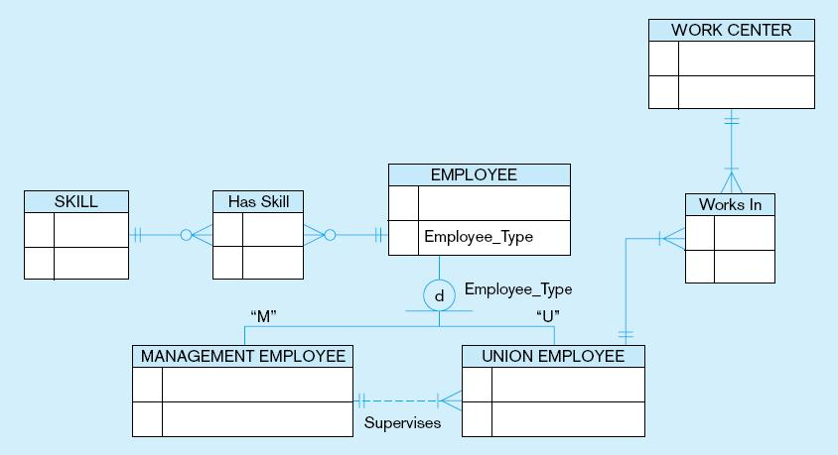
Figure 4-14 Manufacturing entity cluster
Detail for a single cluster

